Slide 1
Structured Data Manager Essentials Overview
Secure Content Management

Slide 2

Agenda
Trends
Customer Challenges
Structured Data Manager Capabilities
Business Value
Customer Success
Competitive Overview
Summary

Slide 3
Trends
Notes:
Let’s take a look at some of the industry trends in the Enterprise Content Management Industry

Slide 4
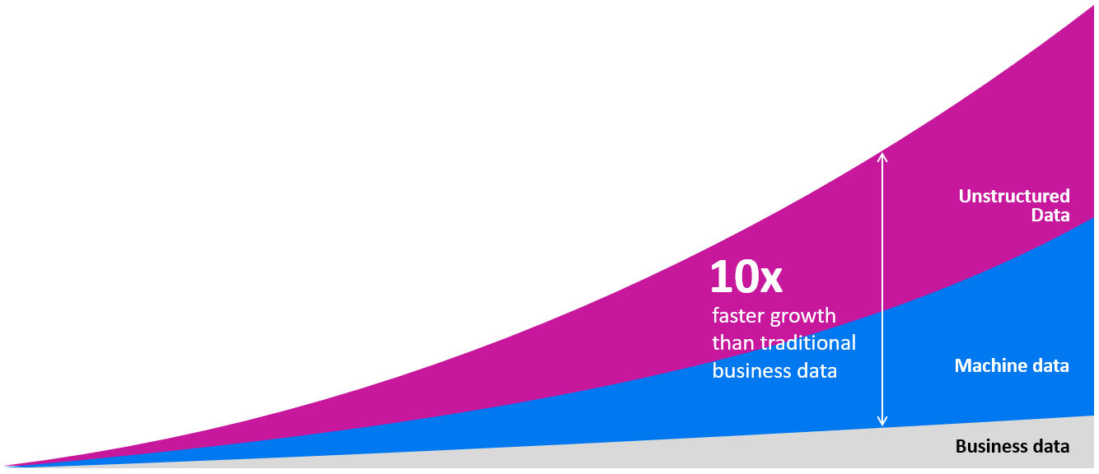
The data landscape has radically changed
More connected people, apps and things generating more data in many forms
Notes:
Traditionally ECM focused on business process and collaboration however with increasing global regulations and privacy concerns these need to be balanced with information security and regulatory compliance across the information lifecycle.
Organizations are looking at ECM systems to help them;
<Click> Enhance customer focus by having accurate, relevant and contextual information,
<Click> Improve time to market with greater insight and increased efficiency,
<Click> Increase productivity with automation and workflow tools
<Click> Manage the cost of business systems and staff, by integrating where possible and removing time consuming manual tasks, and
<Click> Ensure information is secure and privacy maintained according to regulation and policy
<Click> Organizations are undergoing varying degrees of enterprise transformation in order to better manage and leverage their business information. Policy-driven management of enterprise content is the key.

Slide 5
Structured Data – a recurring problem
Explosion of Data Footprint
Escalating TCO
Diminishing service levels
Data volume growing exponentially
Increased storage footprint and costs
Application performance degradation
No Information Lifecycle Management policy
Increased database management costs
Lengthening backup and recovery windows
Notes:
Traditionally ECM focused on business process and collaboration however with increasing global regulations and privacy concerns these need to be balanced with information security and regulatory compliance across the information lifecycle.
Organizations are looking at ECM systems to help them;
<Click> Enhance customer focus by having accurate, relevant and contextual information,
<Click> Improve time to market with greater insight and increased efficiency,
<Click> Increase productivity with automation and workflow tools
<Click> Manage the cost of business systems and staff, by integrating where possible and removing time consuming manual tasks, and
<Click> Ensure information is secure and privacy maintained according to regulation and policy
<Click> Organizations are undergoing varying degrees of enterprise transformation in order to better manage and leverage their business information. Policy-driven management of enterprise content is the key.

Slide 6
Customer Challenges
Notes:
Let’s take a look at the how these trends relate to customer challenges.

Slide 7
Inactive structured data – out of control
Clone
Clone
Inactive
Inactive
Clone
ERP
Inactive
Inactive
+
Legacy
DB
Legacy
DB
Clone
Clone
Inactive
Inactive
Legacy
DB
Legacy
DB
Clone
CRM
Inactive
Inactive
Clone
Clone
Inactive
Inactive
Clone
SCM
Inactive
Inactive
Notes:
Most organizations have a number of business applications they use on a daily basis.
They also have a number of applications that are not used frequently but they have accumulated over time. For example it is common to create clones of production databases for a variety of reasons like development and testing. Organizations can also have a number of legacy applications as a result of mergers and acquisitions. For example, if Firm A buys Firm B and they both use different Customer Relationship Management or CRM systems they may agree to use one system going forward but will keep the old one in case they need to access the historical data.
In some instances customers may purchase newer business applications and will keep the old version, for example a HR department may chose to switch their systems from PeopleSoft to Workday as it offers richer functionality. They will continue to keep the older PeopleSoft application should they need to access the information within it.
It can become very easy for the inactive structured data within an organization to grow out of control
As customers add more and more to the database, the growth is multiplied by these clones which may compromise productivity
Creates a huge amount of inactive data in an expensive environment.
Also increases risks as the data within the clones may not be properly goverened.

Slide 8
Manage growing problem of inactive structured data
  Security
  Compliance
  Loss of skills on legacy data
  Storage
  eDiscovery
  Investigations
Increased Risks
Hidden Costs
Diminished IT Value
Lower
Productivity
  Decreased response time
  Slow performance
  IT resources
  End user productivity
Notes:
These situations create real problems for the organization unless the root cause is addressed
Risk –security risk, data spoliation, managing data out of compliance with regulations & policy (internal and external)
Cost – obvious costs like storage, and also less obvious like eDiscovery and investigations because you don’t have to search each repository and create SQL queries
Diminished IT value –because you’re bogging down applications
Productivity – IT team (dealing with these problems) and for end users who suffer from poor performance of the applications they’re using

Slide 9
Roles and Drivers
Govern data throughout lifecycle
Improve preservation of data
Greater insight to information
Risk Management
Chief Compliance Officer (CCO)
Lower IT operation costs
Efficient access to information
Control information footprint
IT Optimization and Productivity
Chief Information Officer (CIO)
Application portfolio optimization
VP of Applications
Application Retirement
Maintenance of application performance
Notes:
There are three key roles to target each with their own driver.
The Chief Compliance Officer. They are responsible for Risk Management within the organization. This individual needs to ensure that information within business applications are governed throughout the lifecycle, the data is persevered and be able to gain greater insight into the information.
The Chief Information Officer is concerned about IT Optimization and Productivity – they are responsible for lowering IT operation costs, accessing information efficiently and controlling the information footprint
The VP of applications is responsible to optimize the overall application portfolio, this can be achieved by retiring older applications and maintaining application performance to ensure operational efficiency.
Our solution is designed to help all three of these roles achieve their outcomes by effectively managing their structured data within business applications.

Slide 10
Solution Capabilities

Slide 11
Structured Data Manager: how it works
Production
Database
SDM
Ingest/Search
Cloud Storage
Search
Active Data
Inactive Data
Ingest
Ingest/Search
Archive Repository or Content Manager
Legacy
Database
Search
Inactive Data
Vertica Analytics
Ingest
Ingest/Search
Notes:
Let’s start by looking at how Structured Data Manager works/
Three key things to reinforce:
Structured Data Manager can access inactive data sitting in both production and legacy databases – it has pre-built integrations to a robust selection of repositories
An intuitive UI and natural language universal search (not requiring without SQL queries) allows users to identify data to be move and then extract this data
Targeted data can then be migrated to a variety of repositories,
Primary take away:
Structured Data Manager presents a clear opportunity to defensibly dispose of legacy data or migrate it to a variety of places for additional analysis and long-term management

Slide 12




Structured Data Manager
Enterprise Management for Structured Data
Performance Optimization
Reduce data footprint & storage costs
Maintain application performance
Improve backup & recovery
Application Retirement
Decommission redundant applications
Preserve access to retired data
Test Data Extraction
Extract subsets of data for use in application development
Mask sensitive data
Search & eDiscovery
Index application data for free text search across silos
Identify and extract relevant sets of data for legal
Notes:
Using Structured Data Manager, organizations can achieve a number of outcomes,
The can improve performance by reducing their data footprint and associated storages costs – this will in turn improve the performance of their business applications and improve the time if takes to backup and recover their business application data
Any legacy or redundant applications can now be retired - this results in organizations can save in the licencing, support and maintenance costs of keeping theses applications running. And crucially they are still able to access this information as and when required.
When organizations develop applications they need to have data to test any enhancements. SDM can extract subsets of data that can be used for this purpose while being able to mask sensitive data in order to mitigate and risk.
Searching and eDiscovery – SDM allows organizations to search for data across information silos. This makes searching for information more efficient as previously they would have needed to search through each application individually

Slide 13
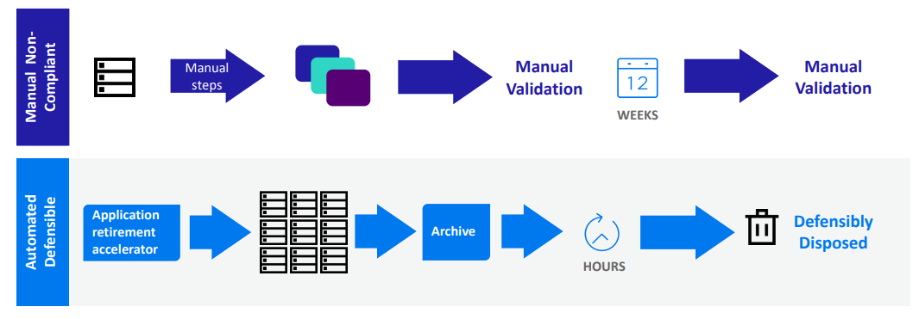
Retire outdated applications
Automate the process of extracting, validating, and deleting data from applications
Lower database maintenance costs
Notes:
Transition: Let’s discuss in more details the customer issues that SDM can solve starting with retiring outdated applications
One of the main benefits is the ability to retire old applications that are being retained just to be able to access old legacy data. To be able to access this data in a semi-automated process can deliver an immediate ROI.
In this diagram, we show the huge difference between a manual process and utilizing SDM to automatically retire old applications
Many customers do not want to address this issue due to the time and resources it takes for this manual process
SDM automates this process resulting in lower database maintenance costs

Slide 14




Apply Information Lifecycle Policies
Move inactive data from production databases to stabilize performance
Provide application access to inactive data
Can Retire records to a “compliance” store as 3rd Tier of Archiving
Provide access to file based archive via SQL reporting tools
Performance
Performance
Predictable, stable performance band
Growth
Growth
Business Application
“Standard” reporting tools
“Archive”
Archive Database
Retired Records
Production Database
Notes:
Transition: Huge amounts of inactive data also affect application performance
Three highlights:
As the volume of data increases – the application performance decreases.
This results in diminishing levels of service, higher operational costs and escalating infrastructure requirements.
SDM can move inactive data from production databases and can retire these records to a more cost effective archive solution. The data can still be accessed whilst stabilizing the performance of the application.

Slide 15

Expedite backup performance
Minimize the backup image required by reducing the volume of data to be backed up
Lower the risk of long disruptions and accelerate disaster recovery
Business Application
Business Application
Production
Monthly
Archive
Archive
Production
Production
Active
Static, compressed
Weekly full
Recovery
Weekly full
Recovery
Monthly full
Recovery
Backups
Backups
Backup
Notes:
Transition: Huge amounts of inactive data also affect back up performance
Three highlights:
As the volume of data increases – so does the length of the backup
Backups may impede on the end users performance time
SDM lowers the risk of long disruptions and accelerated disaster recovery
Main Point: Sometimes these backup issues are ignored until a critical time such as disaster recovery. SDM solves this issue.

Slide 16
Value to Change

Slide 17
Structured Data Manager
“Structured Data Manager takes a unique approach to storing, managing and extracting value from structured data that is based on a robust selection of pre-built integrations to cloud storage, comprehensive information management systems and high performance analytics platform. We believe that the solution provides excellent flexibility and quick return-on-investments for enterprises of all sizes.”
— Sara Radicati, The Radicati Group
Notes:
Here is the feedback from the radicati group in relation to SDM.
As you can see they think very highly of our solution and state how flexible it is and provides a quick return on investment.

Slide 18
Structured Data Manager: customer benefits
Customer Benefits
Retire outdated applications
Automate the process of extracting, validating and deleting data from old applications
Lower costs associated with maintaining these databases, which can number in the 1000s
Reduce data footprint & storage costs
Reduce the amount of (cloned and legacy application) data stored by 50% or more
Lower storage costs, including hardware, maintenance and administration
Enhance operational efficiency
Remove inactive data from production databases to stabilize performance
Avoid violating SLAs and ensure users are happy and productive
Expedite backup performance
Minimize the backup image required by reducing the volume of data to be backed up
Lower the risk of long disruptions and accelerate disaster recovery
Improve search and eDiscovery
Achieve better visibility into, and proactively consolidate, previously difficult-to-access data
Lower costs of eDiscovery and investigations, and increase end-user productivity
Notes:
Three key things to reinforce:
While we’re talking about Structured Data Manager in the context of Information Governance, there are a variety of additional benefits to Structured Data Manager
One obvious incremental benefit is the ability to retire old applications that are kept in place only to be able to access legacy data. For some organizations, the ability to do this in a semi-automated way on thousands of applications is a primary benefit and can deliver immediate ROI
Customers can also improve operation efficiency and backup performance, and also proactively consolidate important data for faster and more cost effective search and eDiscovery
Primary take away:
Structured Data Manager is a key piece of our portfolio and can sit on the front end of an end-to-end solution… but it also can stand on its own and deliver material departmental and pan-enterprise benefits

Slide 19
Customer Success

Slide 20

Essilor
The Challenge
The Requirements
The Solution
  Exponential growth resulted in increasing storage costs and performance issues of their ERP system
  Reduce storage costs
  Continue to deliver exceptional services to business partners and continued business productivity
  Structured Data Manager
  Professional Services
Reduce data footprint and storage costs, including maintenance and administration
Saved $250k annually in storage
Improve competitive advantage through faster and more reliable service to customers and partners
Improve Business SLA response time by 10%
Reduce non-production EBS database size by over 50%
Improve system performance and end-user productivity through greater system availability
Notes:
Cpmpany
Essilor is the leading manufacturer and wholesale distributor of optical lenses in the United States. The company specializes in ophthalmic lens production, manufacturing and distribution, in addition to wholesale optical laboratory operations.
Business goals: Maintain ERP system performance through exponential growth in order to ensure exceptional service delivery to our business partners and continued business productivity while reducing storage costs. Essilor uses Software Professional Services for deployment, implementation and upgrades of SDM products.
High-level overview: Using Structured Data Manager, Essilor of America realized the following benefits:
•Save $250K annually in storage
•Support increased business revenue with greater system availability
•Retain customers with better availability and system reliability. Improve competitive advantage through faster and more reliable service to customers and partners
•Maintain and improve system performance SLAs during ongoing aggressive storage growth
•Improve Business SLA response time by 10%
•Archive and organize data for quick access as needed
•Provide significant performance gains by using Data Archiving products for modules like AR, GL, INV, AP/PO, FA
•Reduce data footprint and storage costs, including maintenance and administration
•Enhance system efficiency, stabilize application performance and provide better response time to end-users
•Reduce non-production EBS database size by over 50%, with 50% savings in storage
•Improve system performance and end-user productivity through greater system availability
•Improve search and eDiscovery in archived data
Benefits
Structured Data Manager ensures predictable, stable performance for end-users and partners by removing massive amounts of inactive data to boost productivity. Due to exponential data growth through acquisition, Essilor storage costs were high and also performance bogged down, diminishing the ability to deliver contracted performance SLAs to business partners. By using Structured Data Manager, Essilor leverages existing storage by identifying and archiving data, thereby posting storage savings of $250K annually.

Slide 21
Competitive Overview
Notes:
Let’s review the summary for this overview

Slide 22
Competitive Overview
Market sector not well defined
Market sector is high value and not commoditized
No recent Gartner Magic Quadrant
Main competitors:
Secondary competitors are: Solix, EMC and PBS Software.
Informatica (Data Archive) | IBM (InfoSphere Optim Data Growth Solution) | OpenText (Archive & InfoFusion)
No. 1 Competitor Broad range of connectors Application Retirement Major account presence (ETL tools) Poor Cloud deployment No unstructured data capabilities | No. 2 Competitor Broad application and database support Strong reference customers Deep information governance expertise and services to support Major account presence | No. 1 Competitor Good file system, app and database support Leader in SAP (SAP sell it!) No SDM equivalent outside of SAP InfoFusion for App retirement Most similar to SCM Suite
Notes:
This sector of the market isn’t well defined or commoditized and there isn’t a recent Gartner Magic Quadrant to refer to.
Gartner define the space as follows… Structured data archiving technologies help IT leaders retire legacy applications, reduce capital and operating expenses, and meet governance and compliance requirements. Structured data archiving is the ability to index, migrate and protect application data in secondary databases or flat files typically located on lower-cost storage for policy-based retention. It makes data available in context, and protects it in the event of litigation or an audit.
There are however a few companies that we most regularly encounter when positioning SDM at our customers. These are IBM, Informatica and OpenText.
Measured by revenue generated, Informatica are the No.1 in this marketspace. Through the acquisitions of Applimation in 2009 and Tier Data in 2012 they have gained strong capabilities in the areas of data management and archiving. Informatica Data Archive provides the broadest range of application and database connectors for providing compliance and data reduction. Their position as the No.1 leading provider of data integration or Extract/Transform/Load (ETL) software they are present in most large accounts. Application retirement is also provided for many enterprise business software platforms and they provide APIs for other applications that customers may want to retire but continue to access the data it holds. They also have a strong and continuing historical partnership with SecureData dating from prior to our acquisition of Voltage Software. However they have lagged in providing cloud based deployment options and do not have a solution for unstructured data putting hybrid projects out of their reach.
IBM are the No.2 in this market. Through their Infosphere brand and the Optim Data Growth Solution they claim to Manage Data Growth, Improve Application Performance and Minimize Risk. The technology to do so is underpinned by their acquisition of Princeton Softech in 2007. Optim has a broad range of options for both applications and databases and deep information governance expertise backed up by global services capabilities to consult and implement their solutions. Optim has a large referenceable customer base including good references for application retirement. They are however geared toward larger implementations and do not scale down well from a price perspective making them very expensive for most organizations. Optim uses a proprietary data store which effectively locks customer data into their tools. They do not support direct database to database, they require a intermediate stage, which limits scale and performance.
OpenText are the 3rd major competitor in this market. Through organic internal development aided by their acquisition of Ixos in 2006, OpenText Archive Center delivers solutions for archiving and managing the information life cycle of a broad range of enterprise information, including email, files, SharePoint data and structured information, such as ERP data (SAP and Oracle), instant messaging, and web and social content, into a single managed repository. They support a wide variety of deployment options when used in conjunction with their Enterprise Information Management Platform. OpenText have a close and strong partnership with SAP and are the leader in SAP archiving. In fact SAP resell OpenText solutions for SAP making it very difficult to win again them for pure SAP projects.
OpenText is the closest competitor from a data management and governance platform to our own with direct capabilities to compete with our Secure Content Management Suite. Most customer solutions require the OpenText Enterprise Information Management Platform which makes them costly to purchase and to implement especially for smaller organizations.

Slide 23
Summary
Notes:
Let’s review the summary for this overview

Slide 24

Structured Data Manager
Addresses problems of inactive structured data
Exploding Footprint
Analytics Availability
Slow Performance
Policy Management
Notes:
Structured Data Manager is designed to address the problems of inactive structured data within an organization form the exploding data footprint, policy management, analytics and application performance.
Structured Data Manager presents a clear opportunity to defensibly dispose of legacy data or migrate it to a variety of places for additional analysis and long-term management

Slide 25

Thank you

